Slide 1
Welcome to Our Presentation
CSE 103

Slide 2

Presentation Topic
Hospital
Management

Slide 3
Course Co-ordinator Asif Hossain
Group members:
Arifur Rahman- 13101085
Sanjida Sultana-13101088
Sabrina Afrin- 12201054

Slide 4
Topics:
Introduction
Slide Content
Features
Application of Our Project
Equipments
Flow Chart & Diagram
Future work
Information
Conclusion

Slide 5
Contents
Hospital management
Doctor
Nurse
Patient

Slide 6
WHAT IS HOSPITAL MANAGEMENT?
Hospital Management provides a direct link between healthcare facilities and those supplying the services they need. This procurement and reference resource provides a one-stop-shop for professionals and decision makers within the hospital management, doctor, nurse and patient care industries.

Slide 7
Flow Chart
Doctor
Doctor List
Patient
Patient List
Nurse
Nurse List
Doctor Modify
Doctor Delete
Doctor Add
Patient Modify
Patient Delete
Patient Add
Nurse Modify
Nurse Delete
Nurse Add

Slide 8
Future Work
All the database maintain properly
Doctor maintain record manually.
Patient maintain record manually.
Nurse maintain record manually.

Slide 9
Information
System will maintain through internet.
Data will store in internet database.
Patient can contact doctor through internet.
Patient update will also maintain through internet.

Slide 10
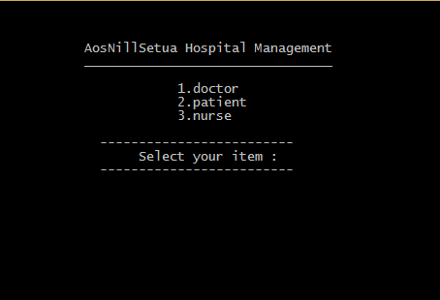
Project Console Layout

Slide 11
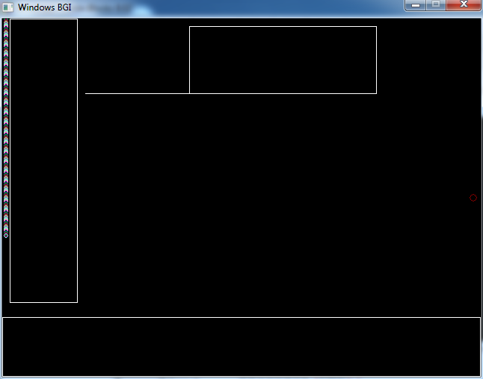
Graphics Project
Graphics project

Slide 12

Thanks To All

